Slide 1

Jeevarathnam R T
Corona virus
Analysis
with SQL

Slide 2
The CORONA VIRUS pandemic has had a significant impact on public health and has created an urgent need for data-driven insights to understand the spread of the virus.
As a data analyst, you have been tasked with analyzing a CORONA VIRUS dataset to derive meaningful insights and present your findings.
Objective

Slide 3
Dataset:
Description of each column in dataset:
Province:
Geographic subdivision within a country/region.
Country/Region:
Geographic entity where data is recorded.
Latitude:
North-south position on Earth's surface.
Longitude:
East-west position on Earth's surface.
Date:
Recorded date of CORONA VIRUS data.
Confirmed:
Number of diagnosed CORONA VIRUS cases.
Deaths:
Number of CORONA VIRUS related deaths.
Recovered:
Number of recovered CORONA VIRUS cases.

Slide 4
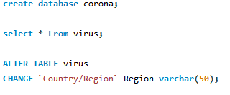
Create a database to store the dataset in MYSQL
Check the tables
Change the table name to easily callable and useful format

Slide 5
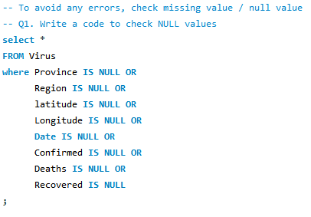
Check for the null values and show the values.
IS NULL - used in where clause to check the null values
This table has no null values.

Slide 6

There no null values so we cannot impute zeros.
If we wanted to impute any null values by zero we need to use
Syntax:
UPDATE [table] SET [column]=0 WHERE [column] IS NULL;

Slide 7


Count function is used to count the values
We can count by column name or for total count of row we can use count(*)
The Total count of rows is 78,386.

Slide 8
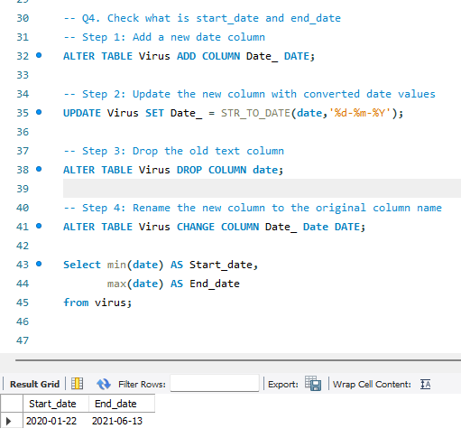
First we need to change the date column to date format
Here we assigned date to new column and updated the column name to previous column name
Drop the date column with text format
Start date = 22-01-2020
End date = 13-06-2021

Slide 9

Here we use date difference to find the difference between two dates
Calculated by month
The number of months present is 16+1= 17Months total.

Slide 10
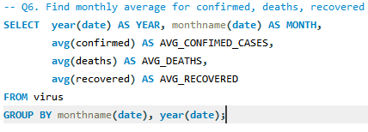
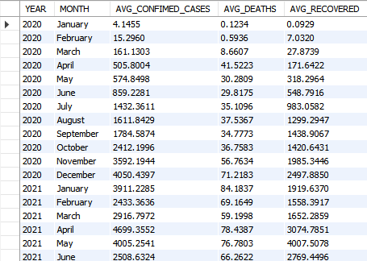
calculated the average confirmed cases, deaths and recoveries
For each month
we used year to avoid months of different years been sum up into single month

Slide 11
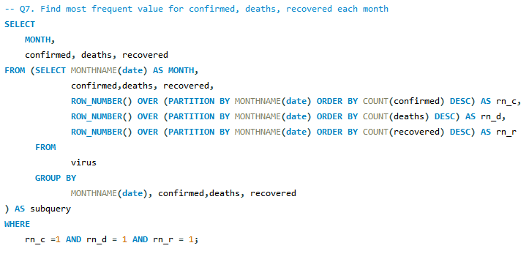
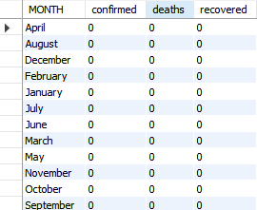
To find the most frequent value for each month
Using subquery within FROM clause
For those three columns we assign row number to by highest occurred value.
In WHERE clause we put condition to get only values with row number 1

Slide 12
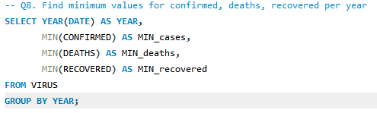

Used MIN() to find the min value for each year

Slide 13
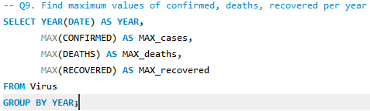

Used MAX() to find the maximum value from dataset for each year
Remember this value is from a single row not aggregated
The values shown have been recorded on single day

Slide 14
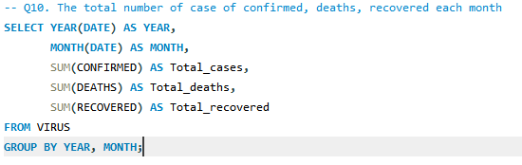
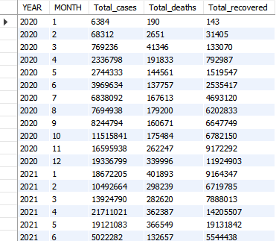
The values shown are aggregated sum of values per month
so we can see till 2020 Sept no of cases been increasing
Normalized at mid and increases at 2021 MAR.

Slide 15
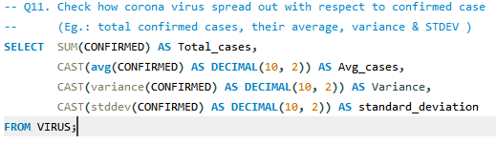

Average cases shows the no of cases confirmed per day
standard deviation shows this values has outliers
This data left skewed

Slide 16
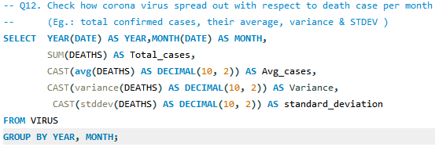
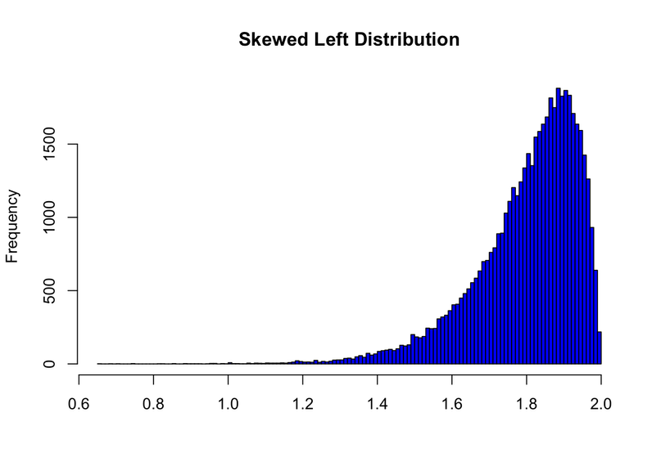
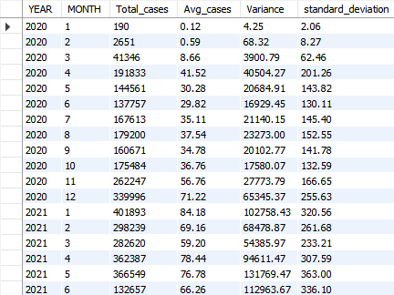
This chart represents Left skewness
There are more outliers

Slide 17
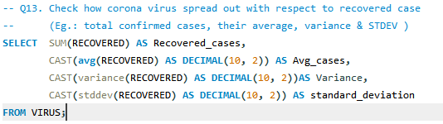

Slide 18
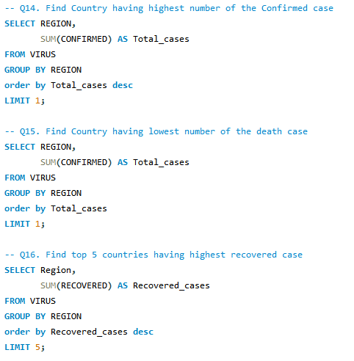

In USA holds 1st place in highest no. of cases recorded
Total sum of 33,461,982 peoples confirmed covid positive.

Slide 19

The lowest no. of confirmed cases are from Kiribati
Hold only 2 confirmed cases.

Slide 20
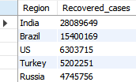
The Top 5 countries with recovered records:
India
Brazil
US
Turkey
Russia

Slide 21


Jeevarathinam969@gmail.com
www.linkedin.com/in/jeeva46/
Thank You

